Slide 1


Slide 2
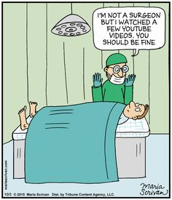
General Problems of Blood Products
RBC, FFP and Platelets are all associated with bad outcome.
Mortality 
Morbidity (Ischemia) 
Infections 
TRALI, TACO 
Transfusion Reaction
Tumor growth
Costs 
Proven for all surgical fields
Musallam K. M. et al. Lancet (2011) 378: 1396
Vivacqua A. et al. Ann Thorac Surg (2011) 91: 1780
Spahn D. R. et al. Lancet (2013) 381: 1855

Slide 3
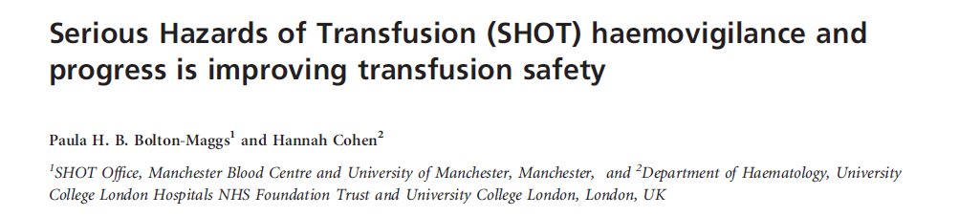
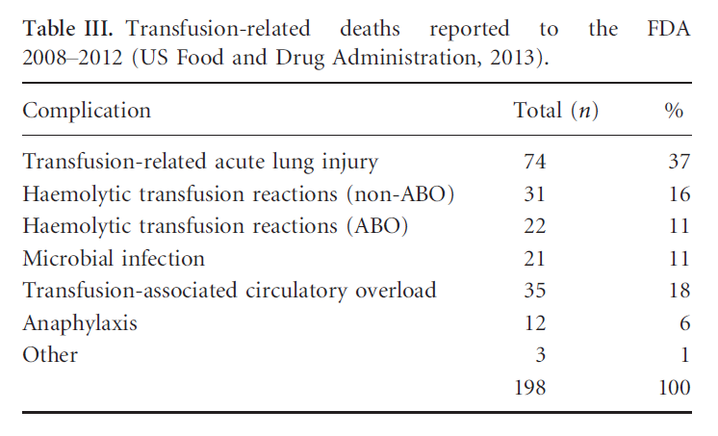
66%

Slide 4

What is the issue?
Inappropriate blood transfusion increases morbidity, mortality & hospital cost!

Slide 5
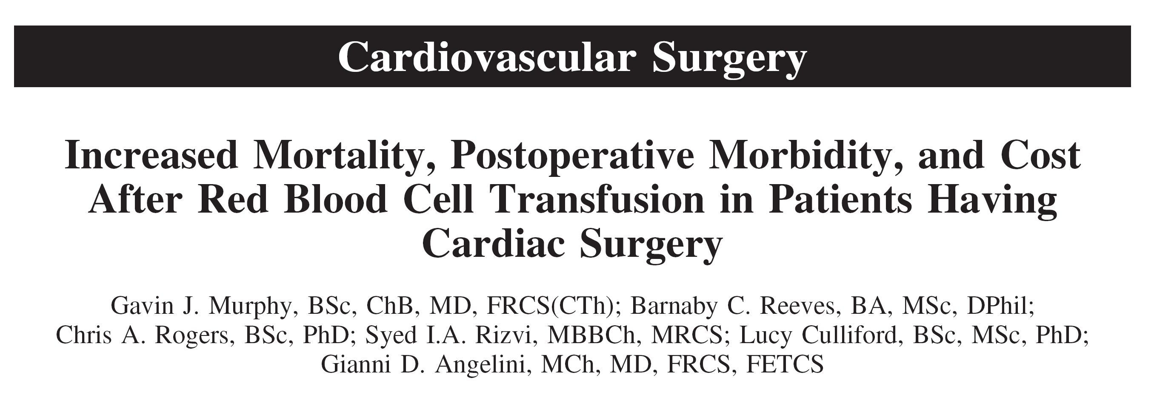
8598 Cardiac Surgery Patients - UK
Period 1996 - 2003
Defined Complications / Adverse Events: Infection, Ischemia (MI, Stroke, renal failure) and Costs
Murphy G. J. et al. Circulation (2007) 116: 2544

Slide 6
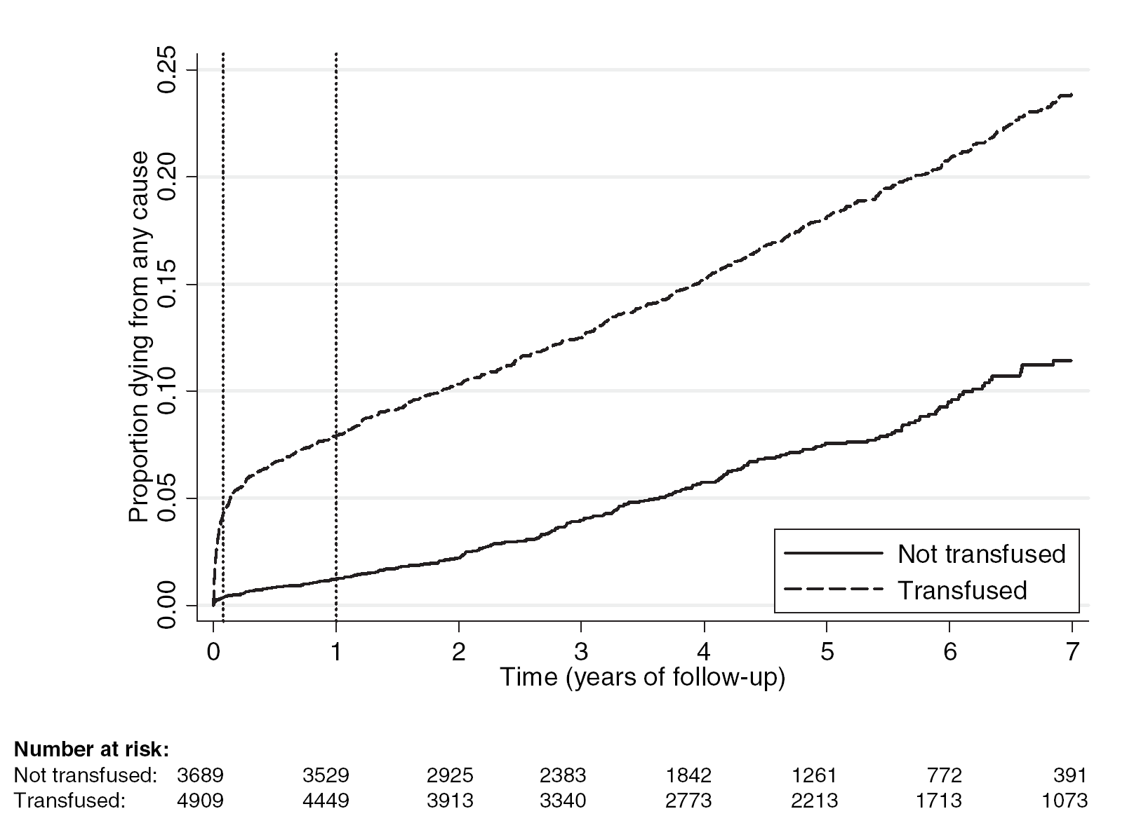
RBC Transfusion and Mortality
Murphy G. J. et al. Circulation (2007) 116: 2544

Slide 7
The American College of Surgeons National Surgical Quality Improvement Program
Surgical interventions 2005 – 2006
N = 125‘223
Bernard A. C. et al. J Am Coll Surg (2009) 208: 931

Slide 8
Mortality
Morbidity
Corrected
Bernard A. C. et al. J Am Coll Surg (2009) 208: 931

Slide 9
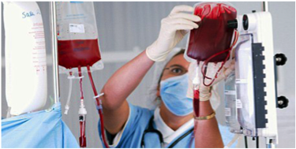
Patient Blood Management
Patient Blood Management (PBM) is the multidisciplinary, timely application of evidence-based medical and surgical concepts designed to improve patient outcome by:
Maintaining haemoglobin concentration
Optimizing haemostasis and
Minimizing blood loss in an effort to improve patient outcome
Source: Society for the Advancement of Blood Management

Slide 10
WHAT IS PBM? …….. Contd ….
A series of ‘rights’
Right Patient
Right Product
Right Reason
Right Time
‘Right’ means?
Clinical decision informed by evidence

Slide 11
Who defines the right?

Slide 12
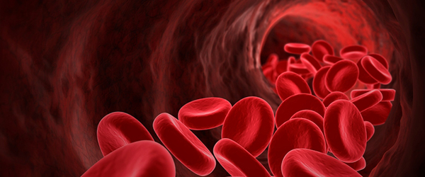
DIAGNOSTIC RESULTS – TURNAROUND TIME
Routine laboratory testing + allogeneic blood transfusion: 90 min
(50 to 70 min) 60 min
+ about 30 min
Lab turn-around time
Time totreat
Thromboelastography + allogeneic blood transfusion: 60 min
4 + 6 + 20 = 30 min
+ about 30 min
S
R
MA
Time to treat
…… BUT

Slide 13
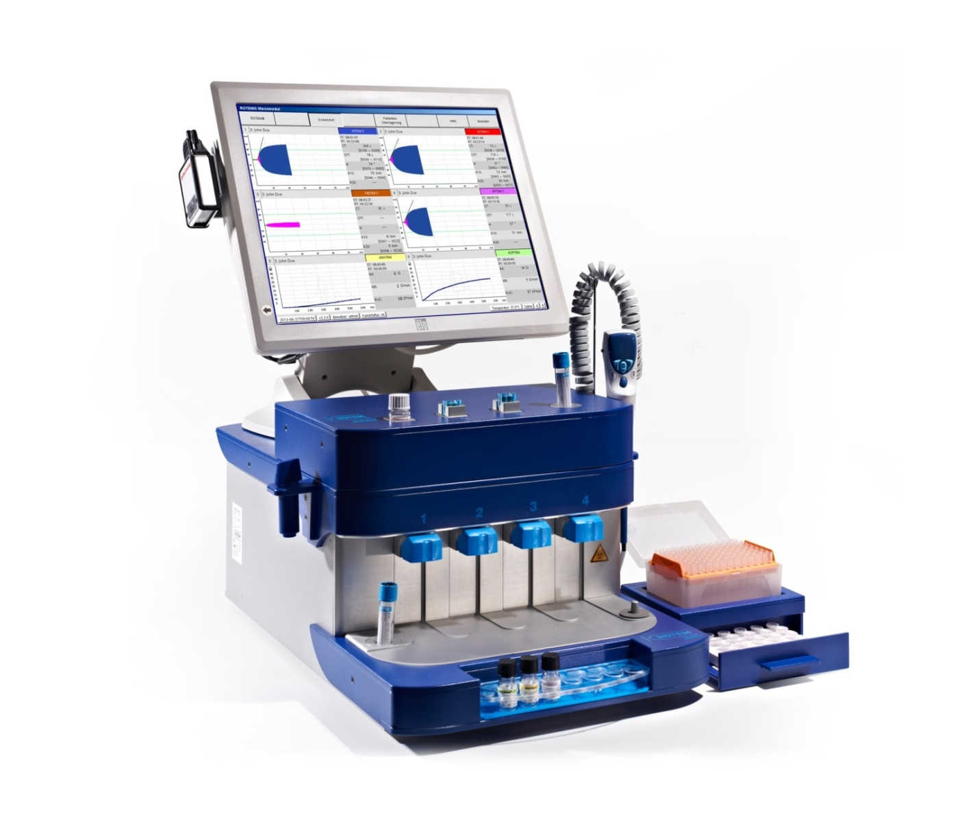
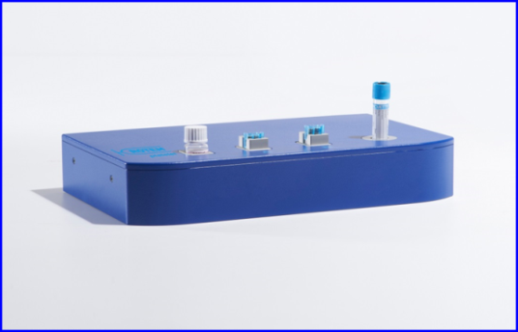
ROTEM®delta
4 Channels viscoelastic tests
ROTEM®platelet
2 Channels impedance aggregometry
ROTEM®
^{(all-in-one)}
Approved by US FDA, CE and Canada Health

Slide 14
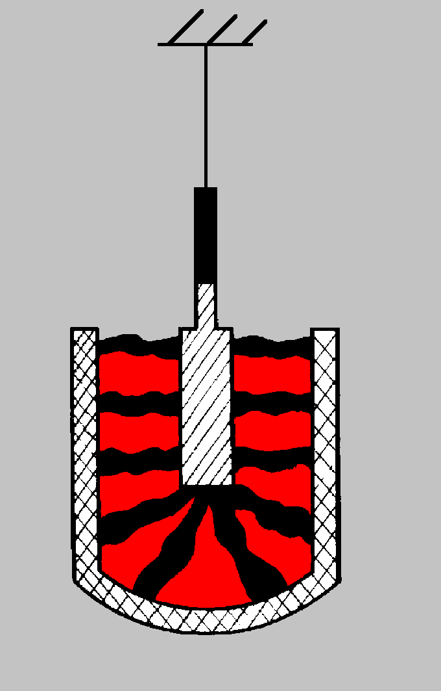
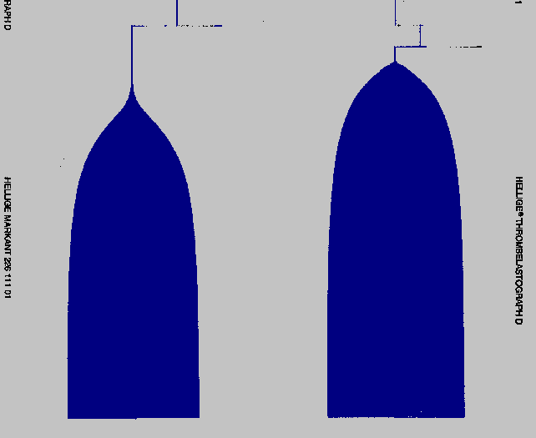
FUNCTION PRINCIPLE OF ROTEM® I
Thromboelastography detection by Professor Hartert (1948)
Motion ofthepin
Torsion
wire
Continuous registration
pin
cup
Blood
clot
Thromboelastogram
4,75°

Slide 15
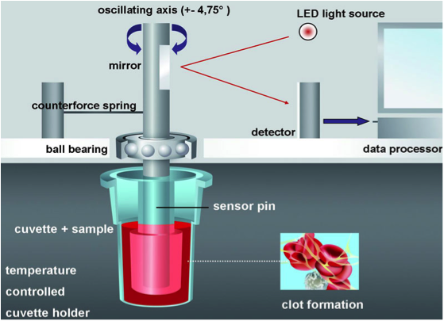
ROTEM – DETECTION METHOD

Slide 16
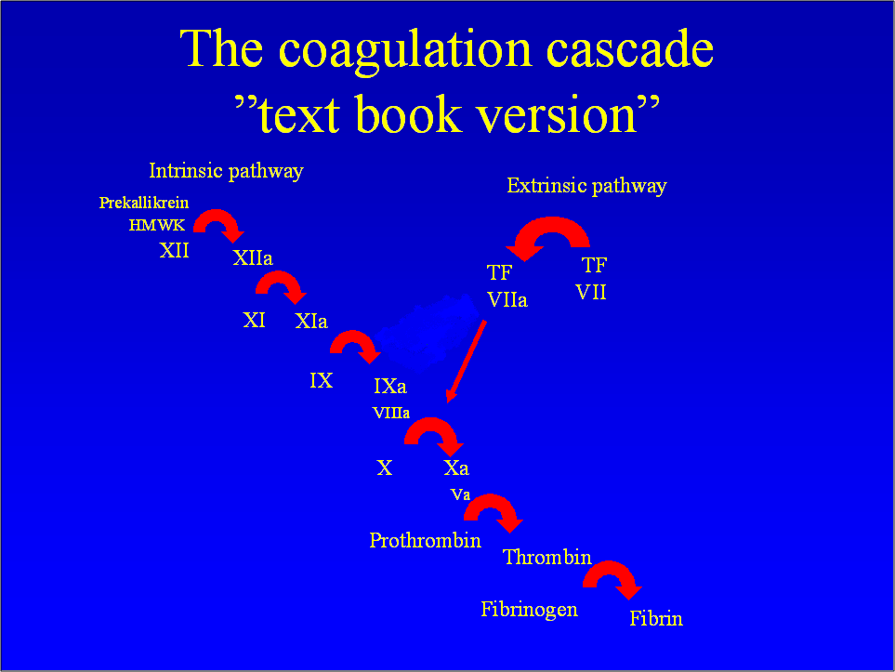
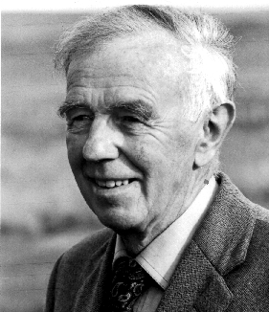
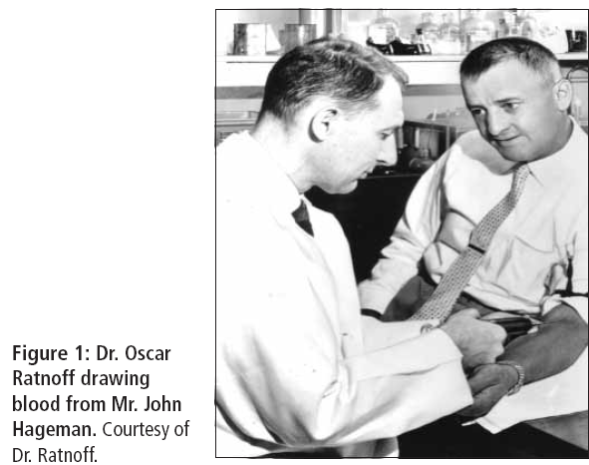
Robert MacFarlane, Oxford, May 1964, Nature
Davie & Ratnoff, Cleveland, Nov 1964, Science

Slide 17
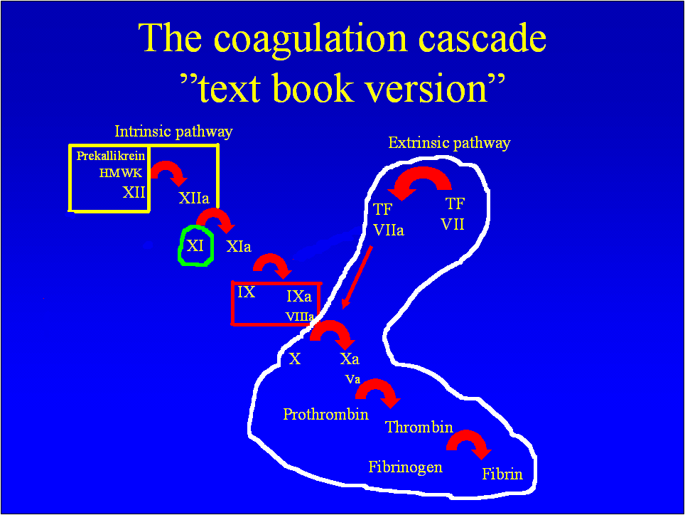

Slide 18
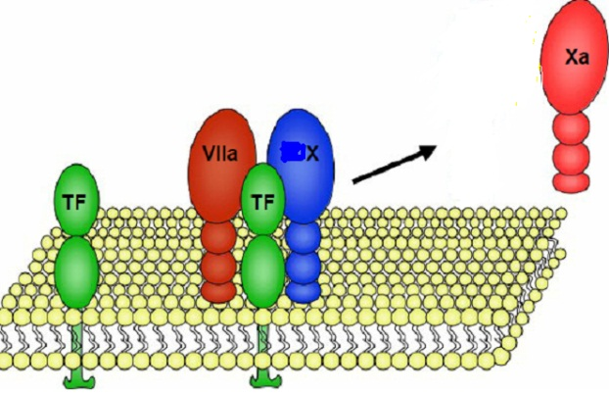
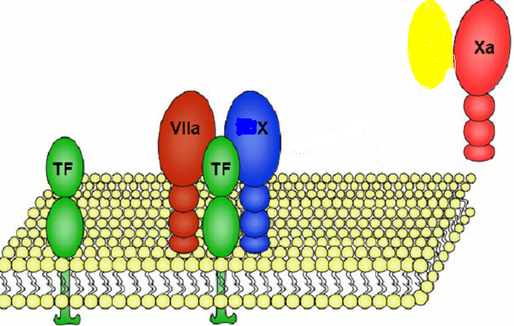
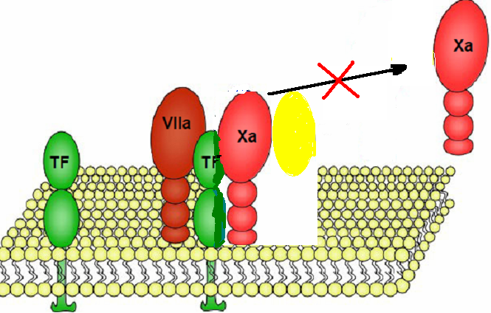
Answers
New protein TFPI- (Tissue factor Pathway inhibitor) - Inhibits or blocks the further action of TF-FVIIa.
TFPI does this after combining with FXa.
Thus contribution from Extrinsic pathway stops.
TFPI
TFPI
Notes:
18
There have been new findings that have thrown new light on this issue
1. TF-FVIIa can activate FIX in addition to FX.
2. Discovery of a new protein called TFPI- (Tissue factor Pathway inhibitor) which combines with FXa and inhibits or blocks the further action of TF-FVIIa. This FXa is generated from the initial Tissue factor release and FVIIa. From this step onwards the extrinsic pathway doesn’t take part in haemostasis.
Cell based model. All the coagulation process occurs on a cell- (Endothelial cell/Platelets/Monocyte)

Slide 19
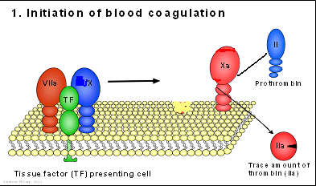
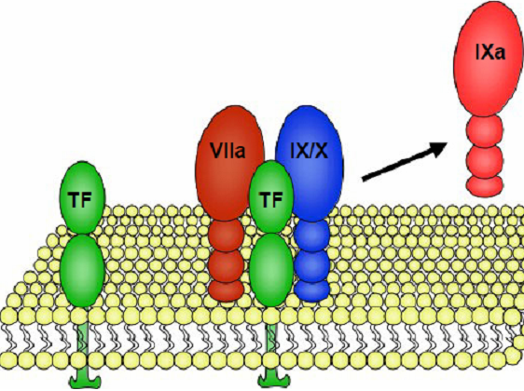
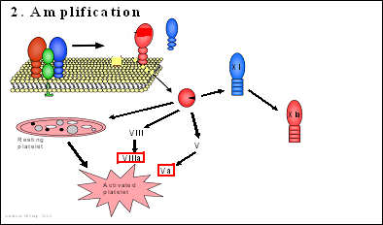
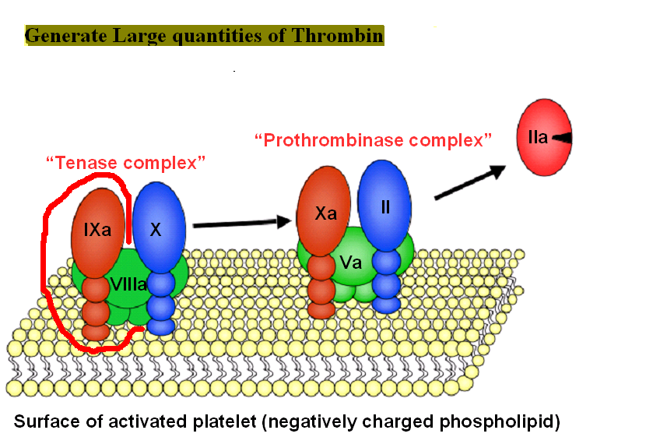
New Pathway 3 steps
Initiation (old extrinsic pathway)
Amplification (old common pathway with added participation from FIX and FVIII)
Propagation (old intrinsic pathway without FXII involved)
Notes:
19
Based on the new findings a new pathway is presently is in use that incorporates the essence of the cascade but overcomes the issues raised.
The clotting process is initiated once TF is exposed or released which usually happens after injury. Like in extrinsic pathway it activates FX and also FIX. Once FXa is generated the extrinsic pathway is blocked by TFPI. The activated FIXa generates a lot of thrombin as FVIIIa is available following the latter’s activation by thrombin formed from the initiation step. Therefore this step is called amplification due to the acceleration obtained following generation of lot of thrombin. Continuity of thrombin generation happens from the old intrinsic pathway process initiated by FXI which is activated by thrombin.
From these steps it is very clear how important FIX, FVIII are in the formation of the clot along with FVII and FX. Therefore their deficiency causes a lot of bleeding. This also is the reason that FXI deficiency the bleeding is not severe. The new pathway also explains why FXII is not at all involved in the process of clot formation and how extrinsic pathway cannot complete clot formation though it initiates it.

Slide 20
Tests for Coagulation disorders
- Whole process as one test
- Test individual process
Test it in small groups
Screening tests

Slide 21
Screening Tests for Hemostasis
Platelet count
Bleeding time (BT) - Plt adh-vWF,Gp1b/ Plt aggr- GpIIb-IIIa/ Plt secretion
Prothrombin time (PT) - Extrinsic pathway factors-VII,V,X,II and Fibrinogen
Activated Partial thromboplastin time (aPTT) – Intrinsic pathway factors XII,XI,IX,VIII,V,X,II,Fibrinogen
Most important is - History

Slide 22
Value of history in Diagnosis
An abnormal coagulation parameter has no major diagnostic value if the patient
is not bleeding
has not been a bleeder ( no past history of bleeding)
not likely to be a bleeder –( no family or medication history)

Slide 23
Limitation of existing standard laboratory methods
We now know that in vivo clotting is initiated by tissue factor (in much smaller doses than that used in PT) and not by contact activation as in aPTT
and that the process is amplified by factor VIII and factor IX.
Does not represent the entire coagulation process – velocity and acceleration of coagulation
Significant changes to the clotting process are missed – efficiency of Thrombin generation
A lot of misses here and there – not complete and not physiological
No contact activation
1/10⁵ TF

Slide 24
Main Measure
THROMBIN

Slide 25
Newer Methods – more accurately represents Thrombin Generation
Thrombin Generation Test/Assay (TGT/TGA).
Thromboelastometry (ROTEM) / Thromboelastometry (TEG)

Slide 26
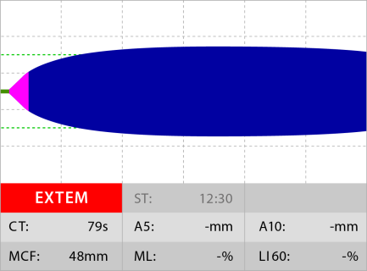
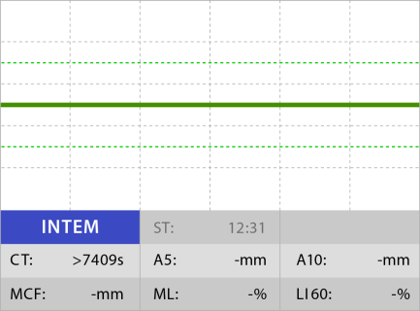
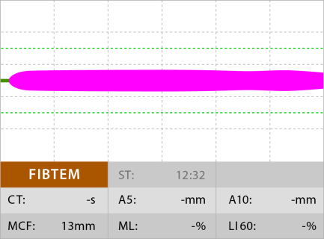
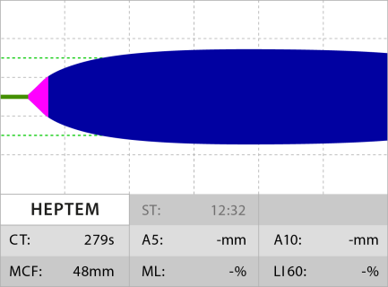
CaCl₂ + Tissue Factor + Polybrene
CaCl₂ + Ellagic Acid
29
38
12
88
EXTEM + Cytochalasin D
INTEM + Heparinase
APTEM = EXTEM + Aprotinin / TXA
ECATEM = CaCl₂ + Ecarin
87
9
10
29
38
27
73
8
92

Slide 27
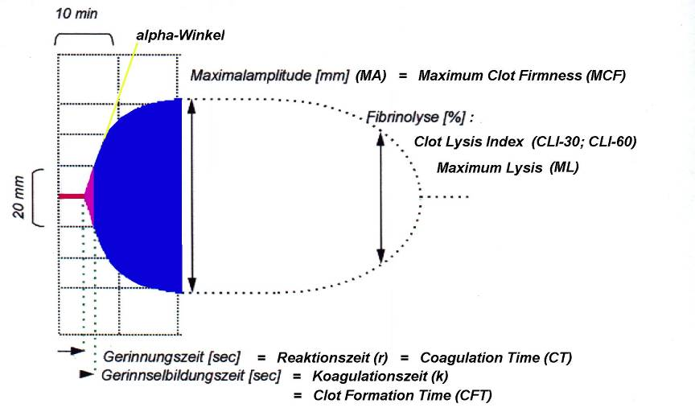
Coagulation factors,
anticoagulants, FDPs,
tissue factor expression
Platelets,
fibrinogen, F XIII, colloids
Fibrinolytic enzymes,
fibrinolysis inhibitors,
F XIII
alpha-angle
Maximum Clot Firmness (MCF) [mm]
Maximum Lysis (ML) [%]
Clot Lysis Index 30 or 60 (CLI30; CLI60) [%]
Clot Firmness [mm]
A5, A10 = Amplitude 5 / 10 min after CT [mm]
SLT gives values but this gives color coded graph for easy interpretation
Coagulation Time (CT) [s]
Clot Formation Time (CFT) [s]
Run Time [min]

Slide 28
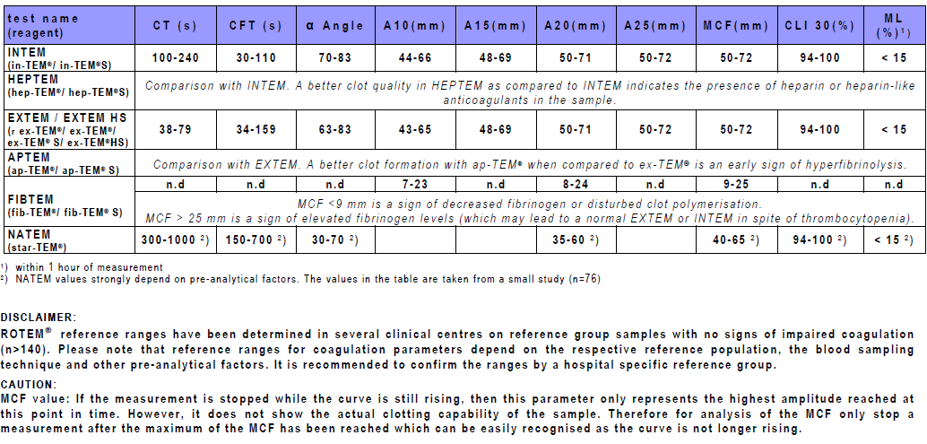
REFERENCE VALUES
Referenz: Lang T, Bauters A, Braun SL, Poetzsch B, von Pape K-W, Kolde H-J, Lakner M. Multi-centreinvestigation on referencerangesfor ROTEM® thromboelastometry (eingereicht in Blood Coagulationandfibrinolysis)

Slide 29
TEMOGRAM 2 - NORMAL PATIENT

Slide 30
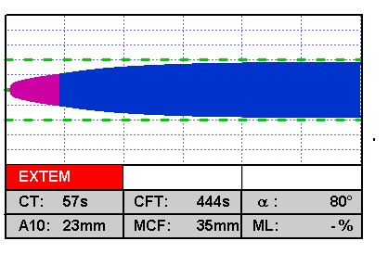
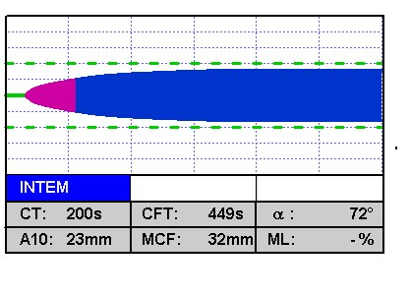
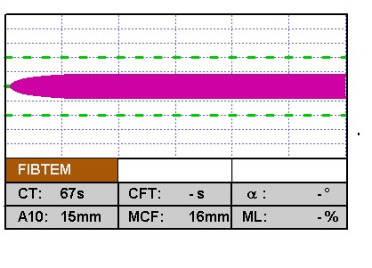
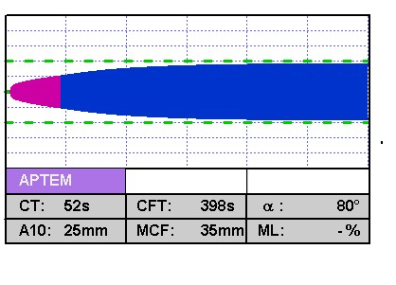
ROTEM TEMOGRAM ………………. 3
EXTEM&INTEM :
Normal CT
Low amplitude
&
FIBTEM:
Normal amplitude
=>fibrinogensufficient
Lowamplitude in EXTEM&INTEM due to
lowplatelet count or plateletmalfunction
APTEM≈ EXTEM
=> No hyperfibrinolysis

Slide 31
EXTEM&INTEM :
Prolonged CT
Low amplitude
&
FIBTEM:
Low amplitude
=>Lowfibrinogen
Low amplitude seen in INTEM&EXTEM due to fibrinogendeficiency
APTEM≈ EXTEM
=> No hyperfibrinolysis

Slide 32
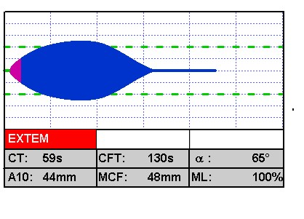
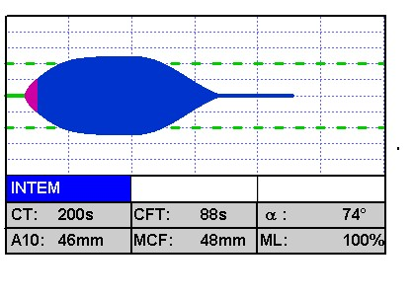
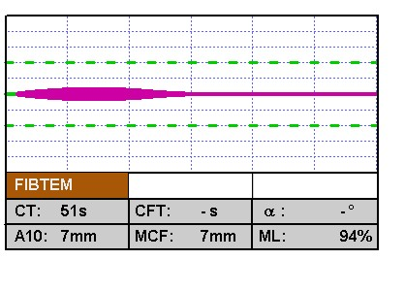
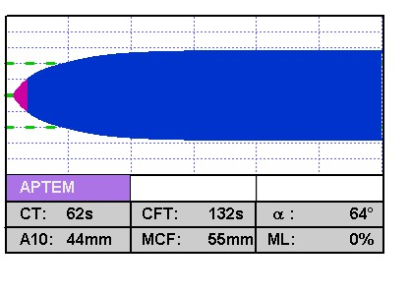
ROTEM TEMOGRAM ………………. 5
INTEM&EXTEM:
Normal CT: no factor deficiency or heparin influence (INTEM)
Slightlylow amplitude: couldbe due to fibrinogendeficiency, plateletdeficiency or hyperfibrinolysis => check FIBTEM &APTEM
Clearclotdegradation =>hyperfibrinolysis
FIBTEM:
Clot degradation
Borderline amplitude
=>here due to
hyperfibrinolysis
APTEM:
Hyperfibrinolysisinhibited
Amplitude back to normal

Slide 33
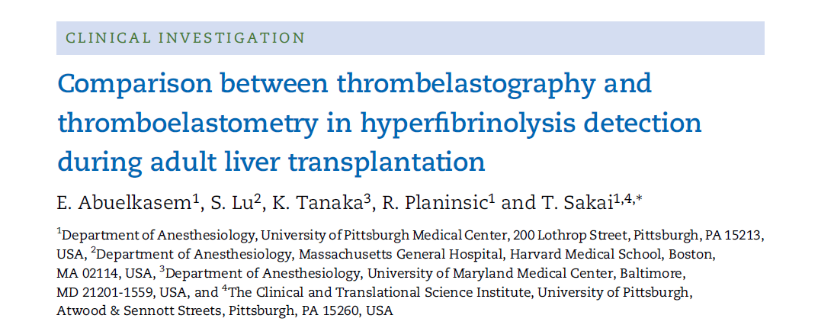
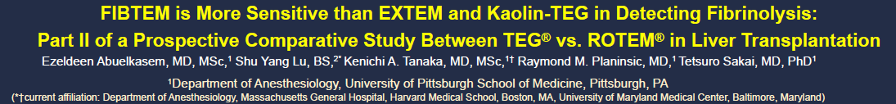
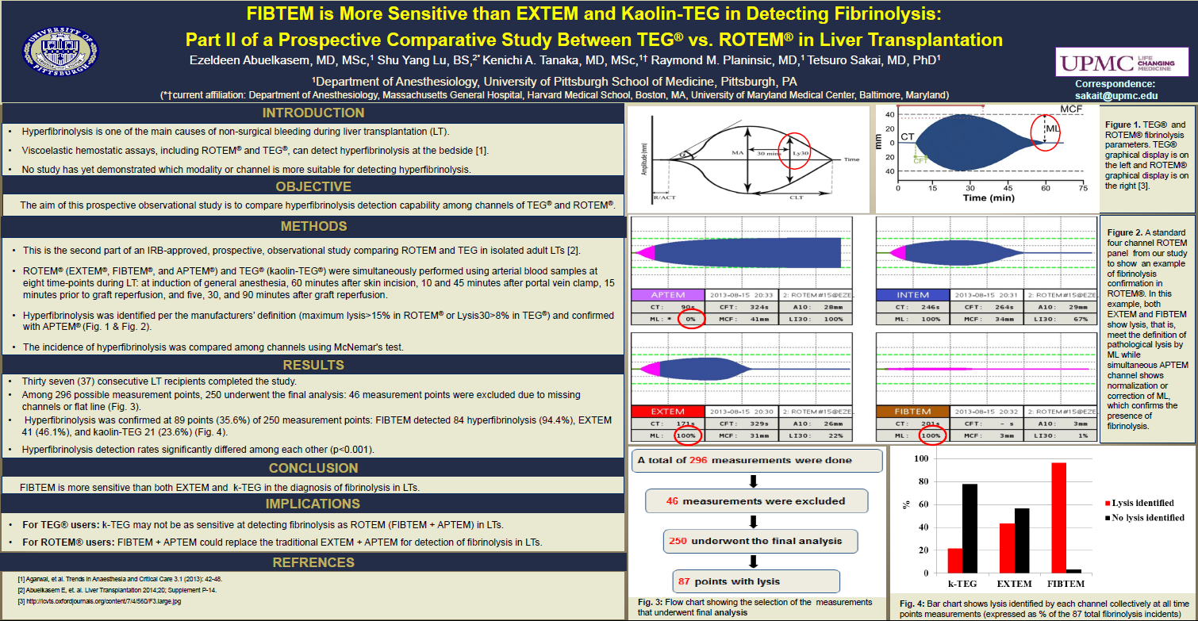
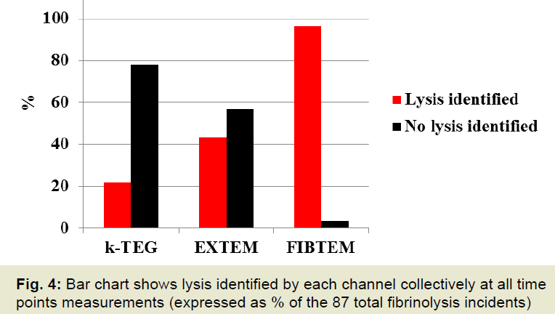
CONCLUSION: FIBTEM is more sensitive than both EXTEM and k-TEG in the diagnosis of fibrinolysis in LTs.
(ASA 2015 Abstract A1046)

Slide 34


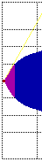
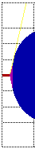
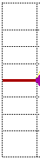

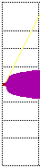
RAPID ASSESSMENT IN ONLY 10 MINUTES
CT
CT
CFT
CT
CFT prolonged
CT
CFT
EXTEM
CFT
A10 decreased
EXTEM
CFT
CFT
A10
A10
in normal
in normal
range
in normal
range
in normal range
CT
CT
CFT
CFT
Prolonged
CFT prolonged
INTEM
CFT
A10 decreased
INTEM
heparin effect
A10
heparin effect?
Factors?
in normal
in normal
range
range
FIBTEM
A10
A10
A10
FIBTEM
in normal
in normal
range
range
in normal
in normal
range
range
in normal range
CT/CFT/A10_{HEP}
are corrected vs
CT/CFT/A10_{IN}
HEPTEM
defective platelet function
/thrombocytopenia
No Coagulopathy
heparin influence

Slide 35
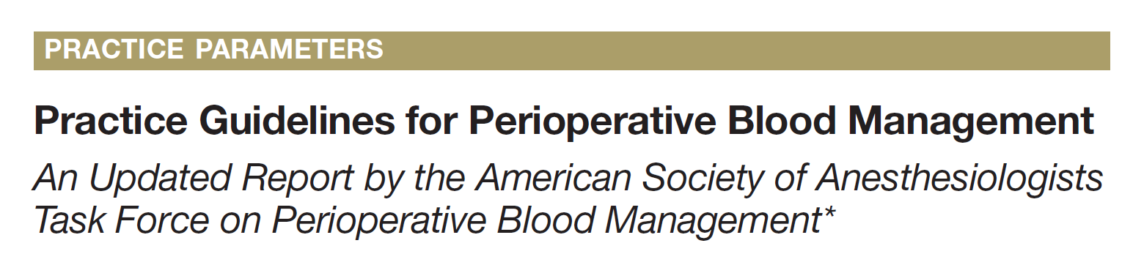
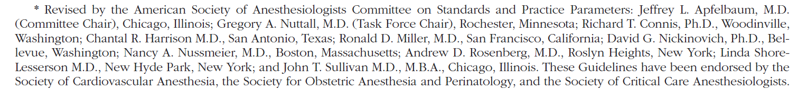
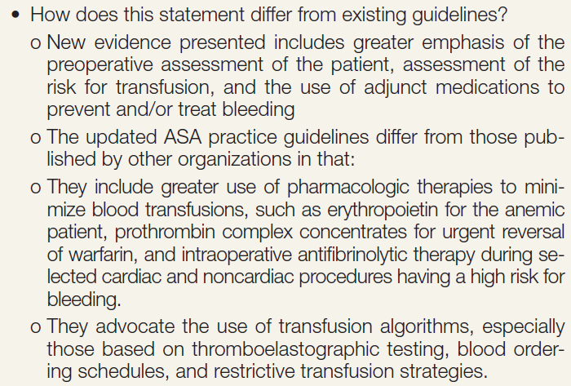
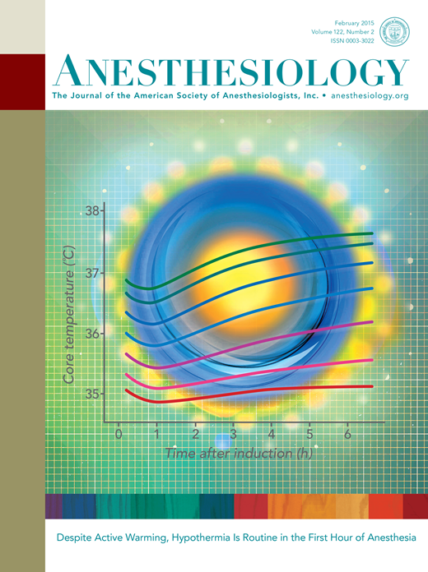

Slide 36
Algorithm Based Approach
Validated and approved Algorithms are available for various procedures like-
Liver Transplant
Cardiac Surgeries
Post Partum Haemorrage
Trauma

Slide 37
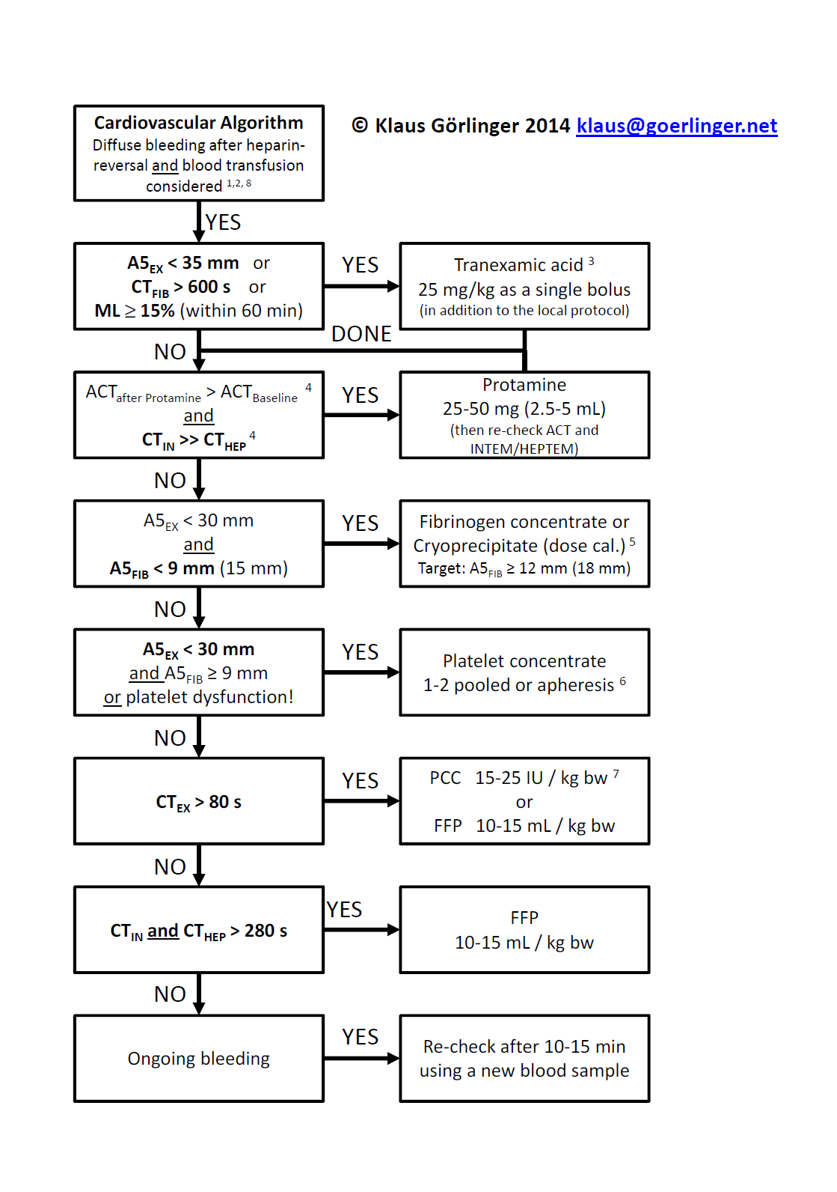

Evidence-based Cardiovascular A5-Algorithm
Clinical Situation
(Hyper)fibrinolysis
Heparin-Protamin-Management
Clot Firmness
Thrombin Generation
Clinical / POC Re-assessment

Slide 38



(Hyper)fibrinolysis Management

Slide 39


A5_{EX}< 35 mm and/or CT_{FIB}> 600 s (FIBTEM® flat-line) → Administration of TXA
LOT
< 45 min > 45 min
A5: 8mm
A10: 9mm
Early Lysis ← → Late Lysis
Defibrinogenation
CT: > 600s
A5: 9mm
Dirkmann D, Görlinger K, Peters J. Assessment of early thromboelastometric variables from extrinsically activated assays with and without aprotinin for rapid detection of fibrinolysis. Anesth Analg 2014 Sep; 119(3):533-42.

Slide 40

Heparin / Protamine Management

Slide 41

Bleedingand CT_{IN}> 240 s → HEPTEM®

Slide 42
Bleeding and CT_{IN}> 240 s and CT_{HEP}/CT_{IN}< 0.8 → Administration of Protamine

Slide 43

Results: During CPB, heparin concentration decreased by 40%, resulting in overdosing of protamine in group 1 (Protamine dose based on the initial heparin dose). Thrombo elastometry revealed longer clotting time (CT) in group I (P value < 0.05). Four patients in group 1 but none in group 2 had excessive prolonged CT values (> 360 seconds) and concomitant microvascular bleeding, requiring substantial replacement of coagulation factors.
Conclusions: Heparin dose-based protamine management leads to protamine overdosing with inhibition of the coagulation process. Protamine management guided by heparin concentrations avoids these complications.

Slide 44


Clot Firmness Management: Fibrinogen

Slide 45





Bleeding and A5_{EX}< 30 mm and A5_{FIB}< 9 mm
→ Administration of fibrinogen concentrate (or cryo)
34 min
A5: 22mm
A5: 31mm
Targeted increase in A5_{FIB} = 8 mm
A5: 2mm
50 mg/kg x 80 kg =
A6: 9mm
4 g Fibrinogen
A5: 20mm
Alternative:
20 U Cryo (300 mL)
or
16 U FFP (3.2 L)
?
A5: 29mm
A5: 20mm
A5: 28mm

Slide 46

A5_{EX}> 25 mm and A5_{FIB}≥ 14 mm and no bleeding
→ No platelet transfusion required
A5: 27mm
A5: 25mm
A5: 15mm
A5: 22mm
Thrombocytopenia (22/nL) compensated by high fibrinogen

Slide 47




Bleeding and normal A5 in EXTEM® and FIBTEM®
but prolonged CT_{EX}> 75 s → 4F-PCC
19 min
175 cm, 110 kg
1500 IU PCC
Alternative:
6 U FFP
?

Slide 48

Measurements and Main Results: The study included 1,077 patients. Clauss fibrinogen was correlated strongly with FIBTEM amplitude (r = 0.78 for MCF and A10; P < 0.01). The area under the receiver operating characteristic (ROC) curve was 0.95; the optimal FIBTEM A10 cutoff for diagnosis of a fibrinogen concentration of< 1.5 g/L was≤ 8 mm.
Conclusions: The FIBTEM was a valid point-of-care method for estimating the fibrinogen concentration during cardiopulmonary bypass and may be used for prediction of hypofibrinogenemia before separation from the extracorporeal circuit.

Slide 49

Clot Firmness Management: Platelets

Slide 50

A5_{EX}≥ 30 mm and A5_{FIB}≥ 9 mm
A5: 35mm
A5: 32mm
A5: 18mm
A5: 33mm
Thrombocytopenia (48/nL) compensated by high fibrinogen

Slide 51


ABS 0; A10_{EX} 36 mm; PC 14 x 10⁹/L
ABS 3; A10_{EX} 27 mm; PC 15 x 10⁹/L
ABS 8; A10_{EX} 23 mm; PC 13 x 10⁹/L

Slide 52
IMPACT OF ROTEM

Slide 53




Slide 54


1718 2147

Slide 55

(thromboembolic)

Slide 56



Slide 57

Evaluation of a Novel Transfusion Alogrithm Employing Point-of-care Coagulation Assays in Cardiac Surgery

Slide 58
ANNUAL SAVINGS IN DIRECT TRANSFUSION COSTS AT TORONTO GENERAL HOSPITAL, CANADA
Product | Number saved (compared to 2012) | Cost per unit* | Total costs
RBC (units) | 1370 | $840 | $1,150,000
Platelet (doses) | 400 | $600 | $ 240,000
Plasma (units) | 1543 | $80 | $ 123,000
rFVIIa (doses) | 30 | $5000 | $ 150,000
 |  | Total | ~$1,700,000†
*Costs: CBS production costs x 2 (activity based costing estimated to be 3-5 times production costs)
† Not including cost-savings due to reduced complications

Slide 59


Slide 60
Δ costs per patient: 1451 €
Costs analysis (in €)

Slide 61
p = 0.112
p < 0.001
p = 0.002
p = 0.031
p = 0.071
Incidence of MT, RT, Re-Exploration and Outcomes

Slide 62
p < 0.001
p = 0.071
p = 0.059
p = 0.495
Incidence of adverse events

Slide 63


Comparison of conventional TEG® technique with ROTEM® technique
TEG according to Hartert 1948
Rotational thrombelastometry (ROTEM)
Rotation movement of the pin is generated by a spring (±4.75º)
Pin hangs free at a torsion wire
Mirror allows contactless detection of pin rotation
High sensitivity against aggitation
Whole blood
Ball bearing axis
Cup
Low sensitivity against aggitation
Whole blood
Cup rotation (±4.75º)
Cuvette holder heated to 37 ºC
Clot formation results in a transfer of rotation from the cup to to the pin (with high susceptibility to agitation!)
Clot formation results in a reduction of pin rotation (with very low susceptibility to agitation!)
2 measuring channels
4 measuring channels
Manual pipette
PC-driven automatic pipette
No internal electronic control
Continuous electronic control
QC every 8 hours (FDA)
QC once a week (FDA)

Slide 64


Interoperator Variability
Intraoperator Variability
The results presented suggest that ROTEM analyses have significantly less variability and superior precision compared with TEG.

Slide 65

CF deficiency intrinsic pw
CF deficiency extrinsic pw
Fibrinogen deficiency
Fibrinolysis sensitive to aprotinin
Thrombocyto-penia
Heparin effect

Slide 66
Cost Effectiveness
Low costs for quality control (once a week in ROTEM® vs. three times a day in TEG®) due to continuous electronic check of pin movements in ROTEM®
Reduction of annual QC costs per device of about $25,000

Slide 67
COST EFFECTIVENESS OF ROTEM
ROTEM® helps hospitals save by substantively reducing:
Inventory costs of blood products
Per patient running costs of, among others:
Operating Theaters
ICUs
Hospital stay
A 10 to 24% reduction in hospital costs is reported in a number of published studies from EU and North America
Potential to increase number of surgeries

Slide 68


ANESTHESIA/CCM
**NEW** Viscoelastic Testing in Liver Transplantation: TEG versus ROTEM

